Slide 1

Early Attempts at Physics Informed Machine Learning (PIML) for
Thermal Modelling of Wire Arc Additive Manufacturing (WAAM)
M.Tech Thesis Stage – I
Department of Mechanical & Aerospace engineering
IIT Hyderabad
Presented by
Jagadeeswaran Murapaka
M.Tech Additive Manufacturing AM22MTECH14001
Under Guidance of Prof. Surya Kumar S.(MAE)
& Co Guidance of Dr. Saketha Nath (CSE)

Slide 2
Contents
Introduction
Wire Arc Additive Manufacturing
Existing approach and Problem statement
PINN Framework
Literature Review
Numerical modelling of WAAM
PINNS and applications
Work progress and Results
PINN applied for Thermal modelling of L-DED
PINN applied for Thermal modelling of WAAM
Challenges encountered and Possible causes
Future Plan
References

Slide 3
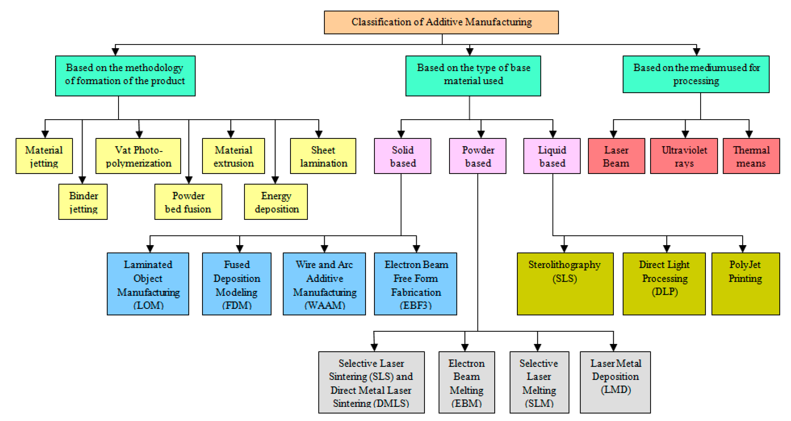
Introduction – Additive Manufacturing
Additive manufacturing (AM) is defined as “a process of joining materials to make objects from 3D model data, usually layer upon layer, as opposed to subtractive manufacturing methodologies”
Fig 1. Classification of Additive Manufacturing [Saad Saleh Alghamdi et al., 2021]

Slide 4
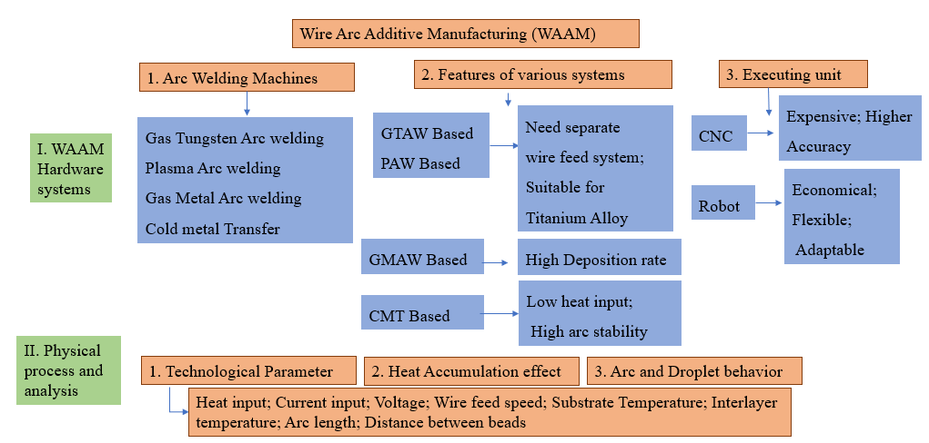
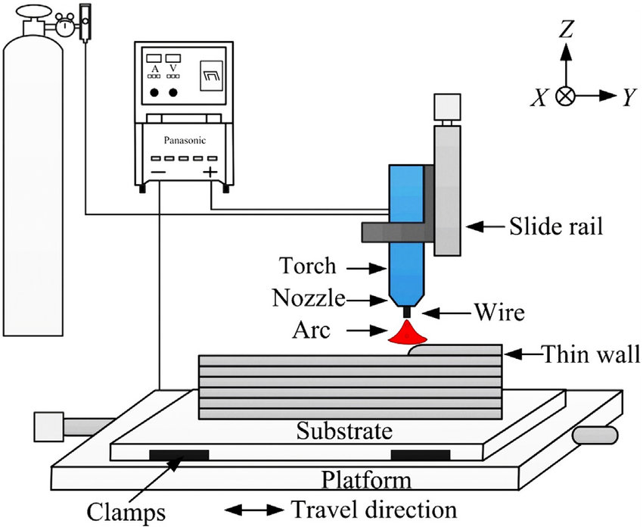
Wire Arc Additive Manufacturing (WAAM)
Arc welding is cost-effective and faster than other AM methods.
It utilizes consumable electrodes ranging from 0.8 to 1.5 mm in diameter.
Uses the GMAW principle for arc creation with inert gas shielding.
Metal is transferred to the workpiece via short circuit, globular, or spray modes(CMT).
Fig 2. Schematic of Wire arc AM Process[ Alagha et al., 2021]
4

Slide 5
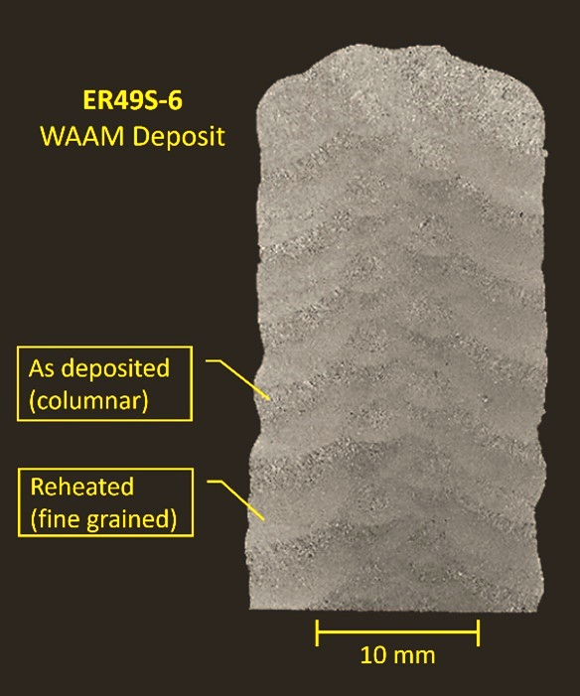
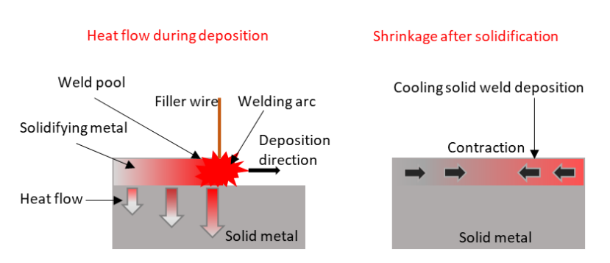
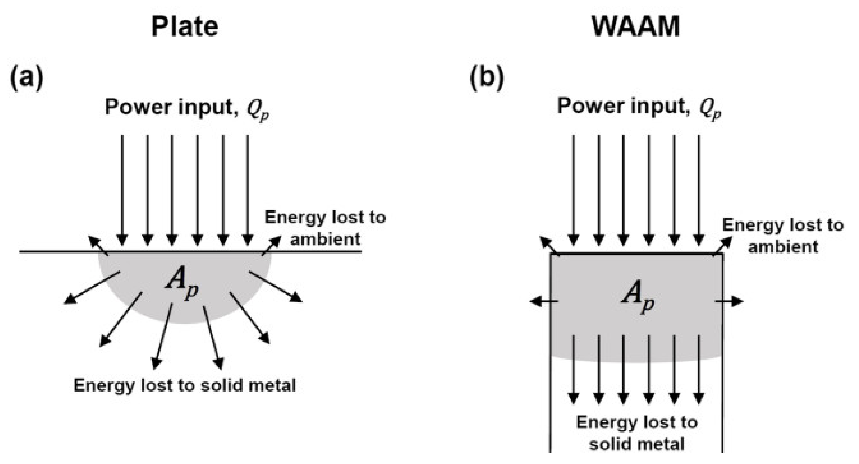
WAAM Contd.
WAAM Advantages: High deposition rate, energy-efficient, cost-effective, material-efficient.
Wide range of Materials: Steel, Nickel, Titanium, and Aluminum alloys.
Deposition Rate: 1 to 5 kg/hr.
Improved buy-to-fly ratio, lower part cost.
WAAM Suffers from:
Heat Accumulation because of reheating
Fig 3: Schematic of Heat flow in AM [Vishwanath Nagallapati,2023]
Residual stress, Distortion
Fig 5 : Macrographic cross section of a typical WAAM deposit (near top), [Jim Galloway, 2022]
Non-uniform properties throughout the built
Fig 4: Direction of heat flow in (a) Arc welding of plate (b) multilayer built in WAAM [Kai Treutler,2021]

Slide 6
Existing Approaches and Problem statement for Thermal Modelling
Huge dependency
Experimental
Numerical Methods
Data Driven ML
Time consuming, Limited observation
of process variation
Computationally expensive; Complex Meshing etc.,
Require Lot of data, Multiple model training, Complexity of model
Although the above methodologies are in practice and has their own advantages, Physics informed Machine learning (PIML) methodology, has its own advantage of modelling the process physics without or with very limited amount of data
PINNS are formulated very recently in 2019 by George Karniadakis et al.

Slide 7
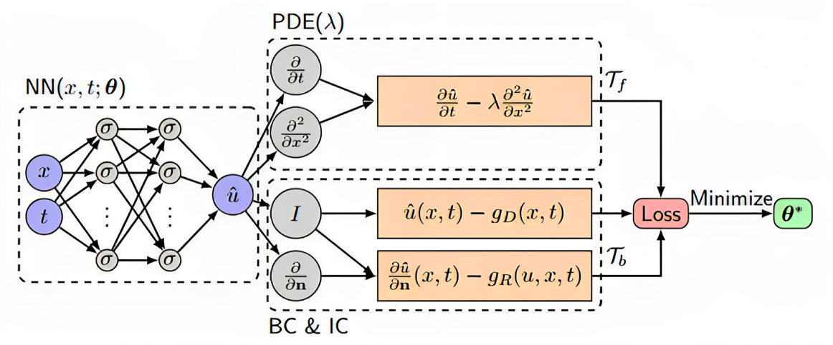
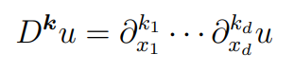
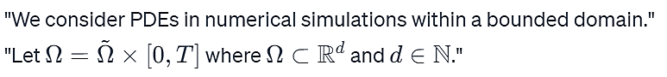
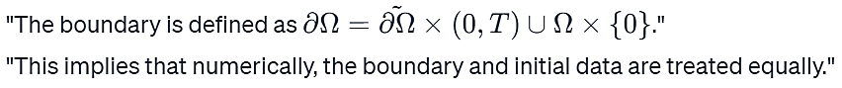
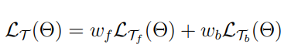
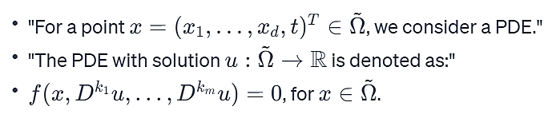
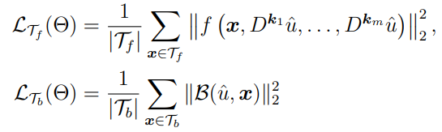
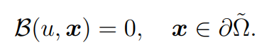
General PINN Framework
Training Process of PINN:
1. Construct Neural network which acts as surrogate solution for u
2. Define your Domain and PDE:
Fig 6: PINN architecture for 1D diffusion equation[6]
Backprop
3. Boundary and Initial Conditions:
DOMIAN:
4. PINN Loss functions:
BOUNDARY AND INITIAL CONDITIONS:
FORMATION OF PDE:
Where,

Slide 8
Why PINNS for Metal Additive Manufacturing (MAM)?
PINNs enhance MAM process analysis by efficiently learning and approximating physics.
They are capable of handling intricate shapes, varying material properties, and integrating experimental data.
PINNs merge physics-based modeling with data-driven learning for better process predictions

Slide 9
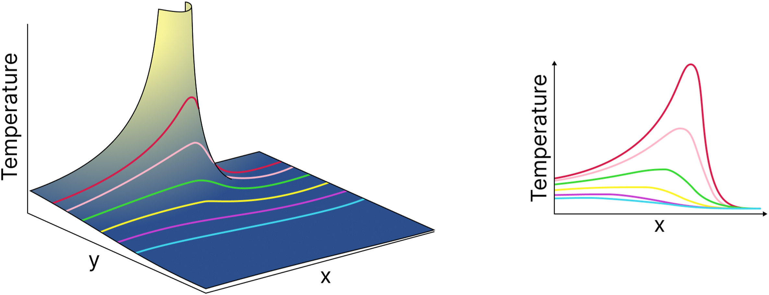
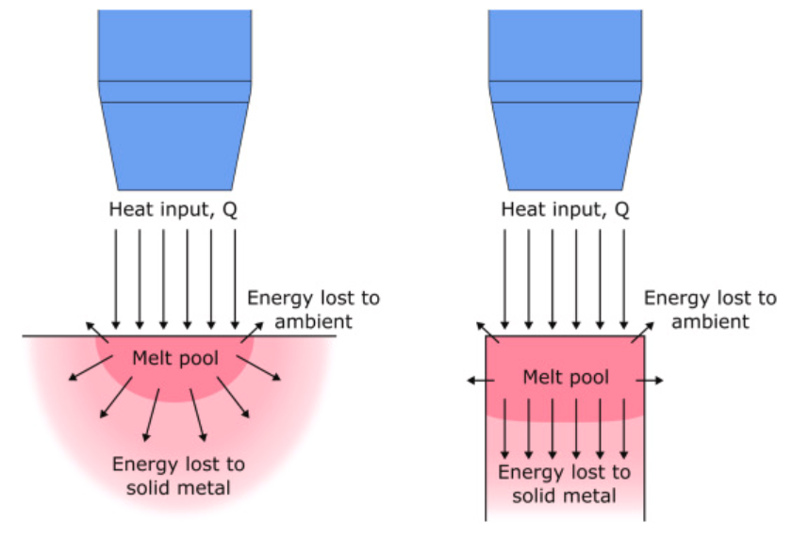
Literature review
Analytical Modelling:
The foundations of the analytical modelling of WAAM are the development and application of the heat transfer equation for moving heat sources in arc welding by Rosenthal’s steady state solution [Kai Treutler et al.,, 2021]
Analytical results deviate from experimental data if radiation and convection is ignored in heat transfer modeling. [Nasiri et. al, 2019]
Also, the Temperature at origin of heat source may increase beyond Melting point of the material. [Nasiri et. al, 2019]
Fig 7: Infinite temperature at start of heat source[Nasiri et. al, 2019]
Melt pool differences between arc welding and WAAM affect melting efficiency due to heat transfer variance.[Mohebbi et al., 2018]
Fig 8: Difference of melt pool cross sections between arc welding and WAAM [Mohebbi et al., 2018]
9

Slide 10
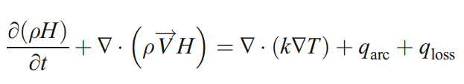
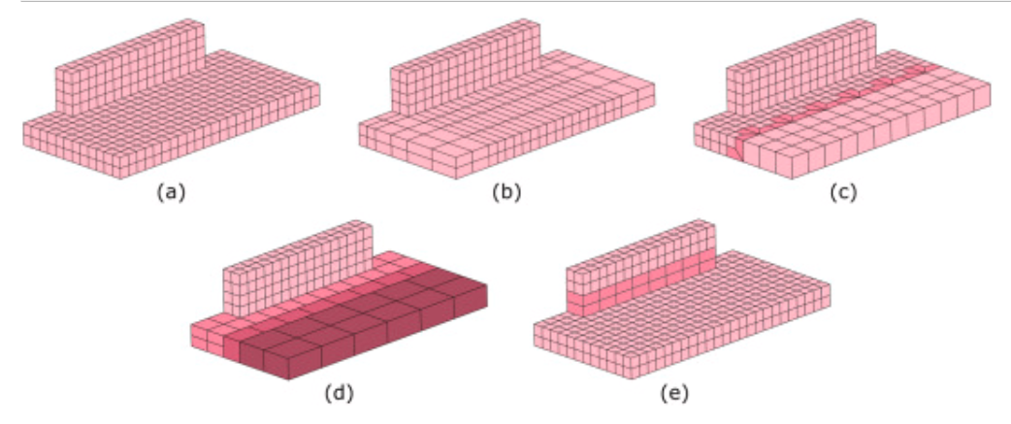
Literature review contd.
Basic analytical models are insufficient for complex welding [Kai Treutler, 2021]
Advanced models like Gaussian distributions are needed for temperature-varying materials and paths.[Kai Treutler, 2021]
Numerical method Approaches:
Energy conservation is fundamental to finite element and other numerical methods.
Hexahedral elements are preferred in WAAM for linear, multi-layer depositions [Filippo Montevecchi, 2017]
Adaptive Meshing is recommended for mesh coarsening and element merging in lower layers of deposited material.[Denlinger et al., 2014 , Jayanath and Achuthan, 2018]
(d)
Fig 9:Meshes: (a) regular, (b) structured biased, (c) unstructured with templates, (d) layer-by-layer coarsened [Denlinger et al., 2014 , Jayanath and Achuthan, 2018].

Slide 11
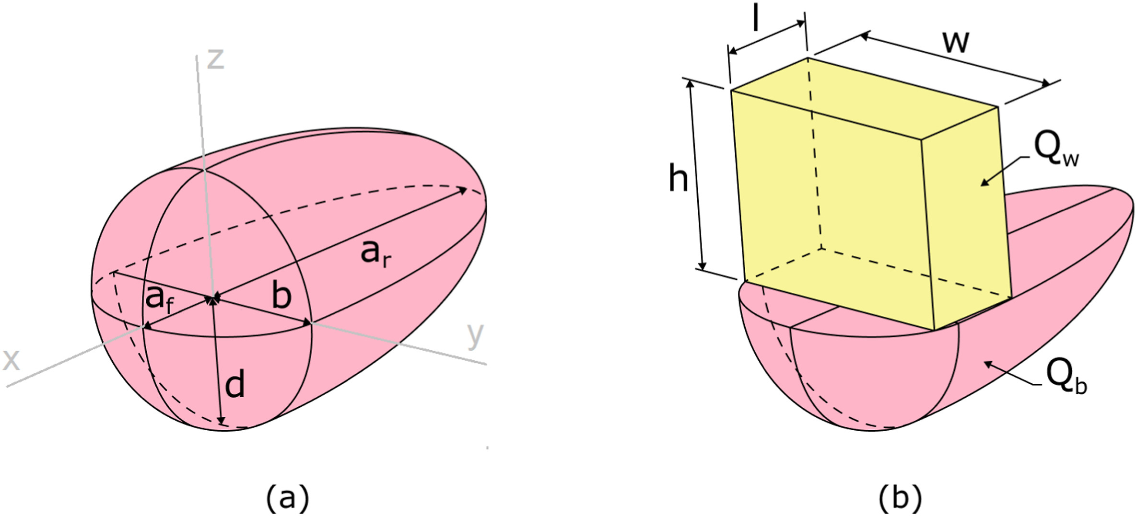
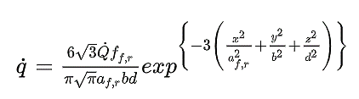
Literature review contd.
Heat source Model:
The double ellipsoid heat source model commonly used in the FEM modelling of WAAM [Goldak et al, 1984]
Asymmetric Gaussian Distribution in X (Feed direction)
b= Half width mm
d= Depth of weld pool mm
af, ar = Semi axis length mm (front and rear)
Fig 10: Goldak double ellipsoidal heat source [Kai Treutler et al.,, 2021]
It has been reported that double ellipsoid heat source model spreads the thermal energy through the melt pool volume more accurately than others [Ding et al.,2014]
In some cases, the calculated temperatures can go above the evaporation temperature and require modification of the intensity parameter in equation [Graf et al.,2018, Ahmad et al.,2018]

Slide 12
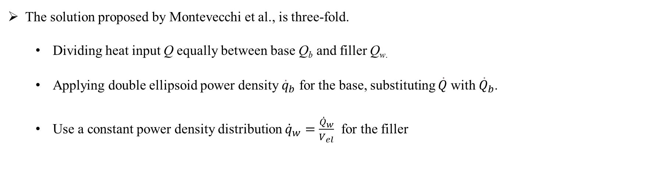
Literature review contd.
The solution proposed by Montevecchi et al., is three-fold.
Dividing heat input Q equally between base Q_{b}​ and filler Q_{w​.}
Applying double ellipsoid power density ${\dot{q}}_{b}$​ for the base, substituting $\dot{Q}$with ${\dot{Q}}_{b}$.
Use a constant power density distribution ${\overset{˙}{q}}_{w}=\frac{{\overset{˙}{Q}}_{w}}{V_{el}}$ for the filler
Fig. 11. (a) The double ellipsoid heat source model and (b) Proposed Droplet Volume approach in WAAM [Montevecchi et al., 2016].
Droplet volume V_{el​} = lwh is represented as a box where heat $\dot{q}v$ ​ is applied to simulate deposition and melting.
[Montevecchi et al., 2016]
The above modified double ellipsoidal model prevents the overheating which the standard model predicts. [Ling et al., 2021]

Slide 13
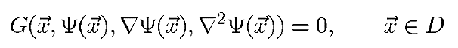
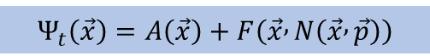
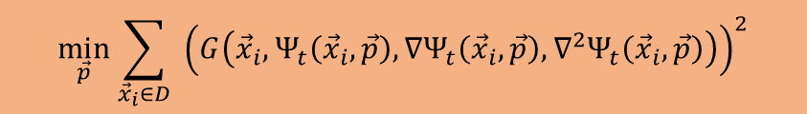
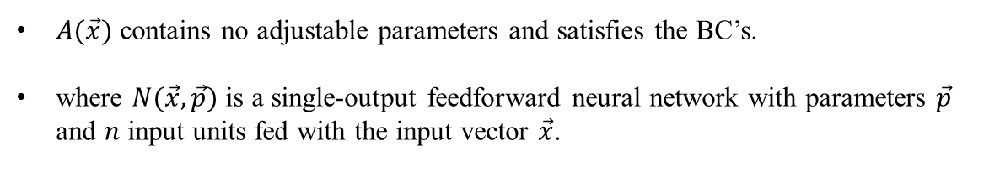
Literature review contd.
PINNS:
ANN’s for solving differential equations [Lagaris et al., 1998]
General differential equation format
Subjected to certain boundary conditions (BC's), for instance Dirichlet and/or Neumann conditions,
Domain $D$ and its boundary $S$ into a set of points $\overset{ˆ}{D}$ and $\overset{ˆ}{S}$, respectively.
The problem is then transformed into the following system of equations:
$$G\left({\vec{x}}_{i},Ψ\left({\vec{x}}_{i}\right),∇Ψ\left({\vec{x}}_{i}\right),∇^{2}Ψ\left({\vec{x}}_{i}\right)\right)=0, ∀{\vec{x}}_{i}∈\hat{D}$$
If $Ψ_{t}(\vec{x},\vec{p})$ denotes a trial solution with adjustable parameters $\vec{p}$, the problem is transformed to:
$$\min_{\vec{p}} \sum_{{\vec{x}}_{i}∈D}{ }{\left(G\left({\vec{x}}_{i},Ψ_{t}\left({\vec{x}}_{i},\vec{p}\right),∇Ψ_{t}\left({\vec{x}}_{i},\vec{p}\right),∇^{2}Ψ_{t}\left({\vec{x}}_{i},\vec{p}\right)\right)\right)}^{2}$$
Proposed Method:
$A(\vec{x})$ contains no adjustable parameters and satisfies the BC’s.
where $N(\vec{x},\vec{p})$ is a single-output feedforward neural network with parameters $\vec{p}$ and $n$ input units fed with the input vector $\vec{x}$.
$$Ψ_{t}\left(\vec{x}\right)=A\left(\vec{x}\right)+F\left(\vec{x} , N\left(\vec{x} , \vec{p}\right)\right)$$

Slide 14

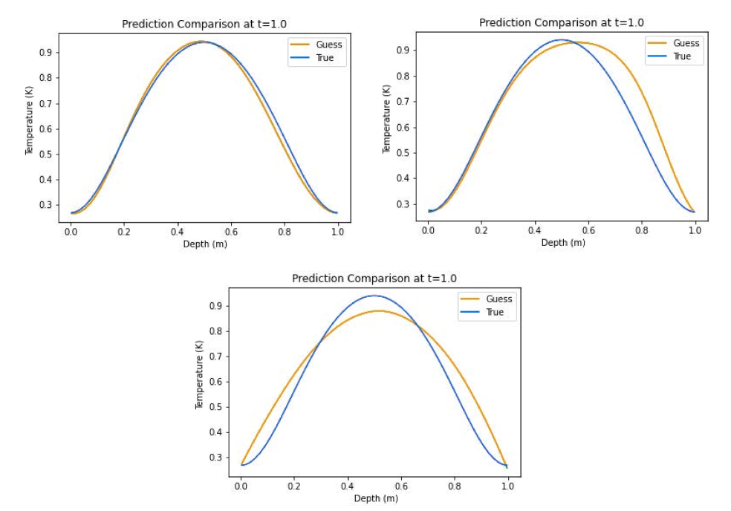
Literature review contd.
PINNs applied to a 1-D Advection–Diffusion–Reaction equation modeling laser energy interaction with skin tissue.[Brett Bowman et al.,2023]
Fig 12: From left to right: epidermis, dermis, and fat.[Brett Bowman et al.,2023]
Collocation points for the PINNs were created using Latin Hypercube sampling.
It was noted that Hybrid and Tanh activation functions might be most effective for PDEs with source terms in PINN models.
Hybrid
Tanh
ELU
Fig 13: Predicted temperature profile along depth.[Brett Bowman et al.,2023]

Slide 15
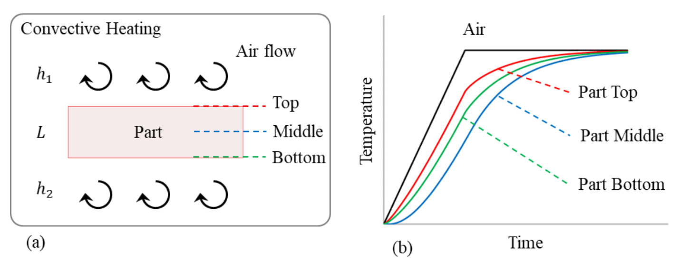
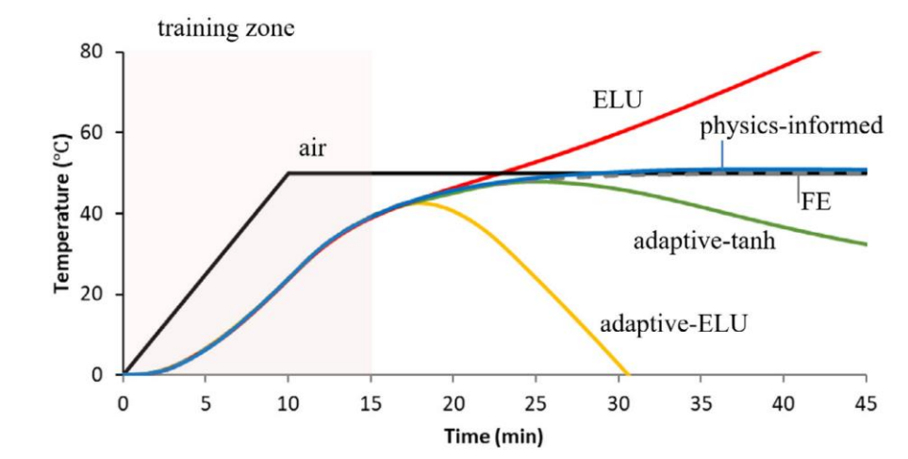
Literature review contd.
Navid et al., 2020 compared data-driven predictions with Finite Element (FE) method results, particularly for the part's center temperature after extensive training.
Fig 14 (a): Convective heating of a part[Navid et al., 2020 ]
Fig 14 (b): Comparison analysis of PINN with data driven for middle section of the part [Navid et al., 2020 ]
They found that they are after 50000 epochs, only PINN approach is correctly able to capture the process and physics and the data driven predictions are deviated from the true temperature curve

Slide 16
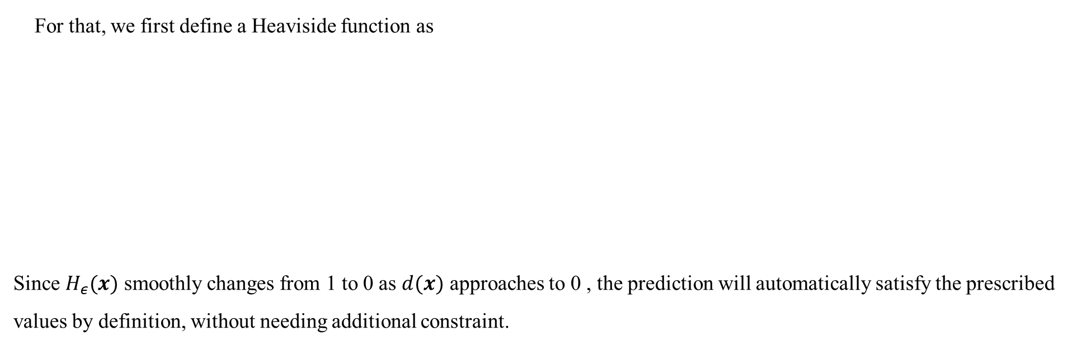
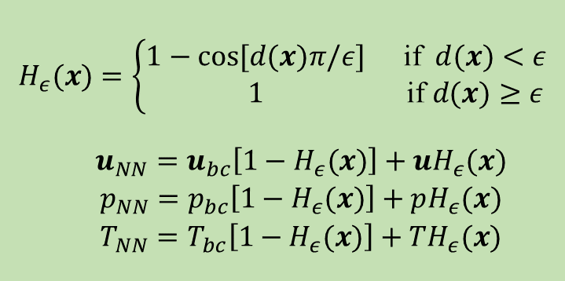
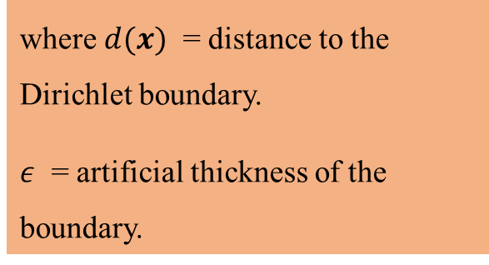
Literature review contd.
Zhu et al., 2021 proposed an idea of considering the Dirichlet BC in Hard approach rather than conventional Soft approach.
A particular portion of the neural network to purely satisfy the prescribed Dirichlet BC.
For that, we first define a Heaviside function as
Since $H_{ε}(x)$ smoothly changes from 1 to 0 as $d(x)$ approaches to 0 , the prediction will automatically satisfy the prescribed values by definition, without needing additional constraint.
$$H_{ε}(x)=\left\{\begin{matrix}1−cos⁡[d(x)π/ε] & \text{if} d(x)<ε \\ 1 & \text{if} d(x)≥ε\end{matrix}\right.$$
$$\begin{matrix} & u_{NN}=u_{bc}\left[1−H_{ε}(x)\right]+uH_{ε}(x) \\ & p_{NN}=p_{bc}\left[1−H_{ε}(x)\right]+pH_{ε}(x) \\ & T_{NN}=T_{bc}\left[1−H_{ε}(x)\right]+TH_{ε}(x)\end{matrix}$$
where $d(x)$ = distance to the Dirichlet boundary.
$ε$ = artificial thickness of the boundary.

Slide 17
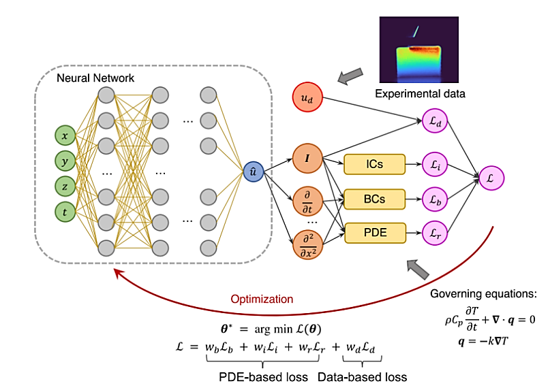
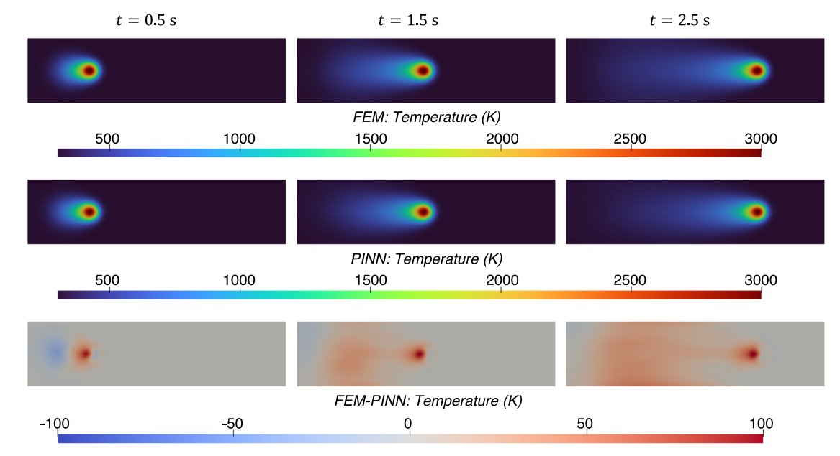
Literature review contd.
Liao et al., 2023, used physics-informed NN to construct a hybrid physics-based data-driven thermal modelling technique for AM operations.
In order to anticipate full-field temperature history and identify unidentified material and process factors, partially seen temperature data from an infrared camera is integrated with the laws of physics.
Fig 16: Temperature profile upto 2.5 sec from top view [Liao et al., 2023]
PINN predicted temperature field matches well with the FEM results, with the RMSE of 14.07 K.
Fig 15: Hybrid PINN architecture [Liao et al., 2023]

Slide 18
Contents
Introduction
Wire Arc Additive Manufacturing
Existing approach and Problem statement
PINN Framework
Literature Review
FEM modelling for WAAM
PINNS and applications
Work progress and Results
PINN applied for Thermal modelling of L-DED → Carried out since decent amount of existing literature
PINN applied for Thermal modelling of WAAM
Challenges encountered and Possible causes
Future Plan
References

Slide 19
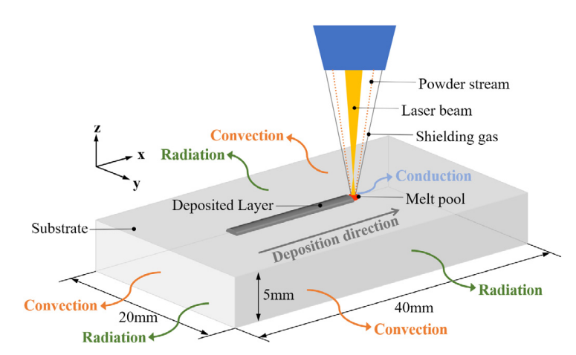
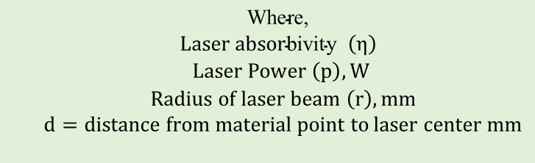
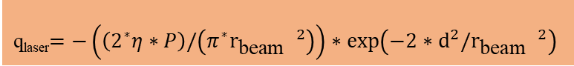
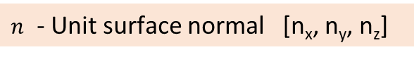
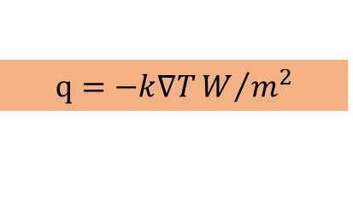
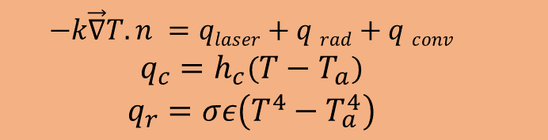
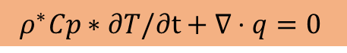
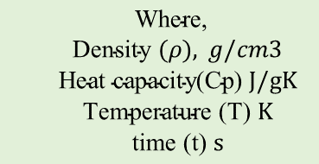
Work progress-Applied to Laser-Directed energy deposition (L-DED)
Governing and Boundary Heat Flux equations:
The governing equation of the transient heat conduction in AM can be written as:
$$\begin{matrix} & \text{Where}\text{,} \\ & \text{Density} (ρ), g/cm3 \\ & \text{H}\text{eat} \text{capacity}\text{(}\text{Cp}\text{)} J/gK \\ & \text{Temperature}\text{ (}\text{T}\text{)} K \\ & \text{time}\text{ (}\text{t}\text{)} s\end{matrix}$$
$$ρ^{∗}Cp∗∂T/∂t+∇⋅q=0$$
By Fourier Law of heat conduction, heat flux $q$ is given by:
Fig 17: Process physics behind Laser DED [Shilin Li et al, 2023]
$$q=−k∇TW/{m^{2}}$$
The Heat source flux is assumed to be applied on only the top surface while the convective and radiative heat flux are applied on all surfaces and can be expressed as
$q_{\text{laser} }$ : Heat flux of Laser
q_{laser}$=−\left(\left(2^{∗}η∗P\right)/\left(π^{∗}r_{\text{beam} } ^{2}\right)\right)∗exp⁡\left(−2∗{ d}^{2}/r_{\text{beam} } ^{2}\right)$
$$\begin{matrix} & −k\vec{∇}T.n =qlaser+q rad+q conv \\ & q_{c}=h_{c}\left(T−T_{a}\right) \\ & q_{r}=σε\left(T^{4}−T_{a}^{4}\right)\end{matrix}$$
$$\begin{matrix} & \text{Where}\text{, } \\ & \begin{aligned}Laser absor\text{bivity} \left(η\right) \\ Laser Power \left(p\right), W\end{aligned} \\ & Radius of laser beam \left(r\right), mm \\ & d=distance from material point to laser center mm \\ & \end{matrix}$$
$n$ - Unit surface normal [n_{x}, n_{y}, n_{z}]
19

Slide 20
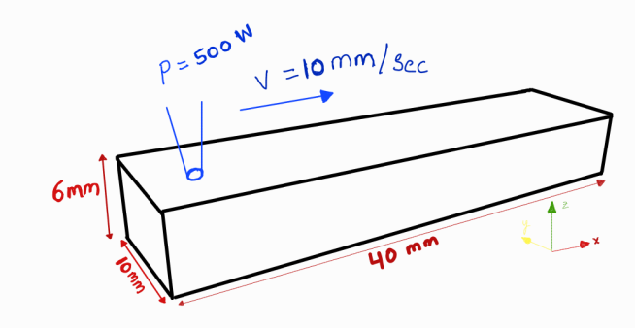
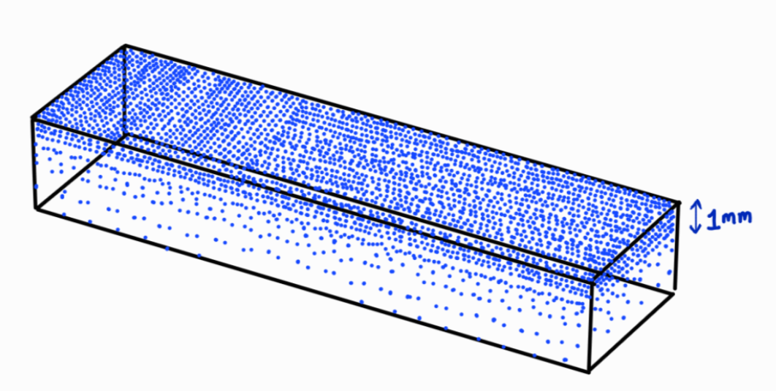
Applied to Laser-Directed energy deposition (L-DED)
Fig 18: Domain considered for the study
Fig 19: Four times finer point distribution at top layer upto 1mm depth
Discretisation of Domain considered:
The domain, measuring 40x10x6 mm, was point wise distributed at 1 mm intervals with a time step of 0.05 seconds
The top layer (40x10 mm up to 1 mm depth) was point wise distributed at a finer interval of 0.5 mm due to higher thermal gradients.
Near toolpath origin also, more points were sampled with mesh grid of 4*4 mm with 0.5 mm intervals for ease of capturing the temperature of surrounding particles from initial state, when heat source is just about to start from its origin
20

Slide 21
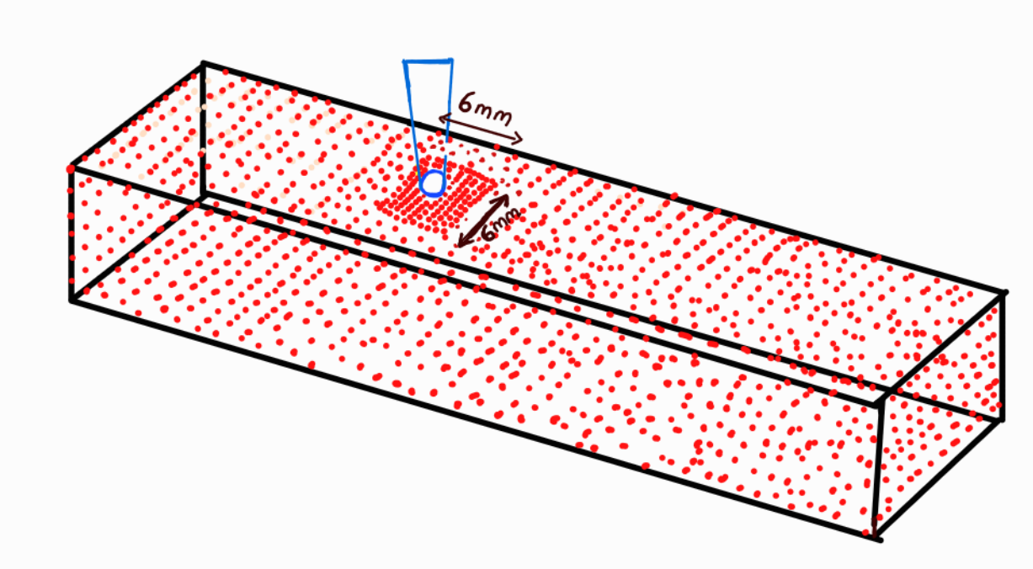
Applied to Laser-Directed energy deposition (L-DED)
To effectively capture the heat flux by the source a finer square point grid of 6x6 mm with 0.25 mm intervals was used near the source area.
Fig 20:Finer square point with 0.25 mm interval in 6*6 mm grid surrounding heat source
Assumption made for the analysis:
The latent heat of phase change was neglected in the material properties because it had little impact on the temperature distribution (Single phase study only)
The internal flow of the melt pool during deposition and heat loss from evaporation were also ignored.
Thermal properties are kept as constant.
Heat flux is applied only to the top surface, while convection and radiation are considered on all surfaces except the bottom, where a Dirichlet boundary condition sets the temperature T at z=0 = T₀​.

Slide 22
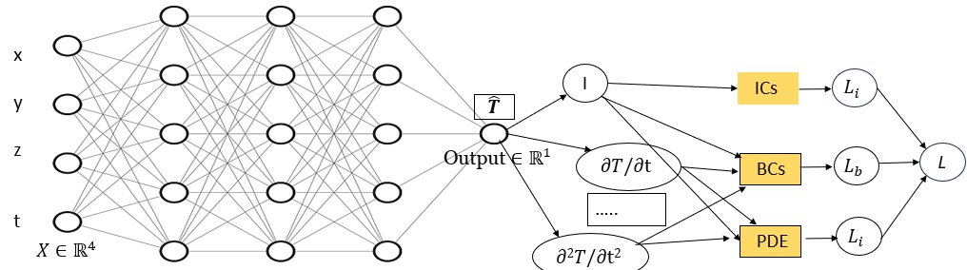
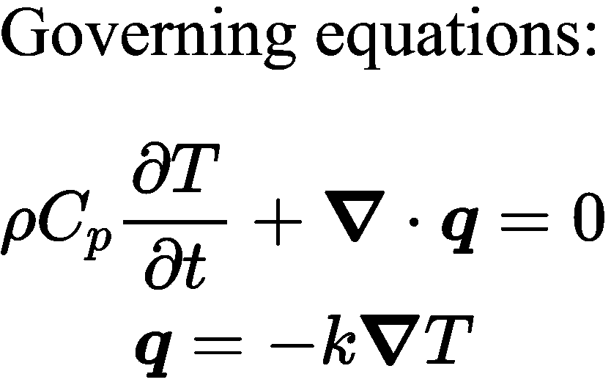
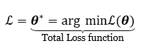
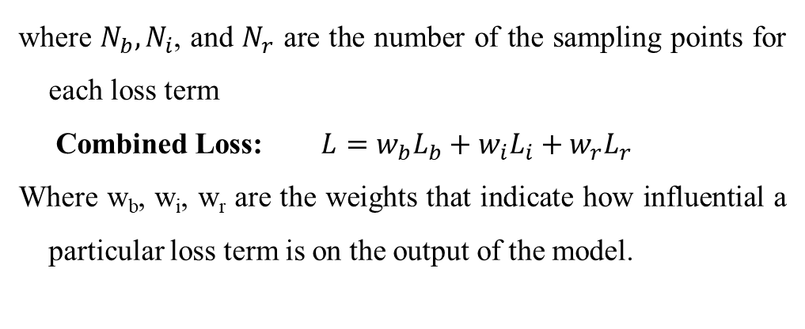
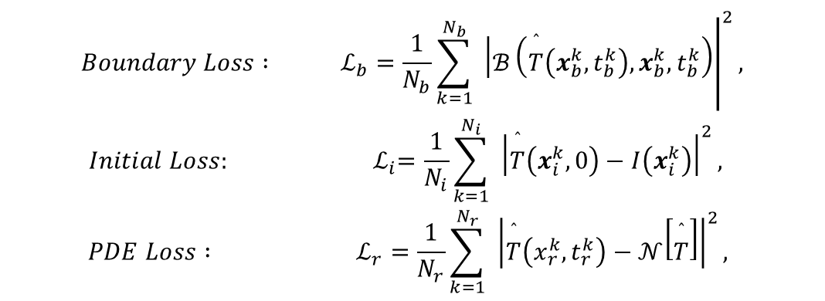
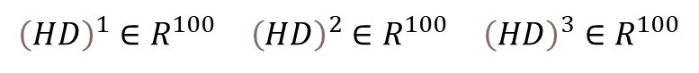
Architecture Followed
$${\left(HD\right)}^{1}∈R^{100} {\left(HD\right)}^{2}∈R^{100} {\left(HD\right)}^{3}∈R^{100}$$
Loss Functions:
Fig 21: PINN Architecture
where $N_{b},N_{i}$, and $N_{r}$ are the number of the sampling points for each loss term
Combined Loss: $L=w_{b}L_{b}+w_{i}L_{i}+w_{r}L_{r}$
Where w_{b}, w_{i}, w_{r} are the weights that indicate how influential a particular loss term is on the output of the model.
$$\begin{matrix}Boundary Loss : & ℒ_{b}={\left.\frac{1}{N_{b}}\sum_{k=1}^{N_{b}}{ } \left|ℬ\left(\overset{ˆ}{T}\left(x_{b}^{k},t_{b}^{k}\right),x_{b}^{k},t_{b}^{k}\right)\right.\right|}^{2}, \\ Initial Loss: & { ℒ}_{i}=\frac{1}{N_{i}}\sum_{k=1}^{N_{i}}{ } {\left|\overset{ˆ}{T}\left(x_{i}^{k},0\right)−I\left(x_{i}^{k}\right)\right|}^{2}, \\ PDE Loss : & ℒ_{r}=\frac{1}{N_{r}}\sum_{k=1}^{N_{r}}{ } {\left|\overset{ˆ}{T}\left(x_{r}^{k},t_{r}^{k}\right)−𝒩\left[\overset{ˆ}{T}\right]\right|}^{2},\end{matrix}$$

Slide 23

Process parameters and Architecture details
Domain and Material Properties considered
PINN Architecture and Hyperparameters considered
Parameter | Value
Space and Time domain
Space and time Domain | L*W*H = 40*10*6 mm, Time = {0, 3} sec
Time steps | 61
Initial Position of Heat source | X₀, Y₀, Z₀ = (5.0, 5.0, 6.0) mm
Laser Parameters
Laser Power (P) | 500 W
Radius of Laser (r) | 1.5 mm
Laser absorptivity ($η)$ | 0.4
Laser Speed (V) | 10 mm/s
Material Properties
Specific Heat Capacity (C_{p}) | 0.5 J/kg.
Thermal conductivity(K) | 0.01 W/mk
Emissivity ($ε$) | 0.3
Thermal conductivity(K) | 0.01 W/mk
Maximum Temperature range | 3000 K
Parameter | Value
Layer Architecture | [4, 64, 64, 64, 1]
Activation function | Linear, Tanh for Hidden, Soft-plus for Output Transform
Epochs | 80000
Learning rate | 2e-4
Input Transform | Normalized between [-1, 1]
Optimizer | Adam
Table 2 :Architecture and Hyperparameters for PINN-L-DED
Table 1: Domain and material properties for PINN – L-DED

Slide 24

Results
Loss | Value
Total Loss | 3.221e-03
BC Loss | 1.128e-02
PDE Loss | 2.759e-03
Time taken for Model Training | Nearly 5.2 hrs on P100 16GB GPU
Rough estimate of abaqus simulation | 7-8 hrs
Fig 22: Loss Curves

Slide 25


Model Predictions
At x, y, z = (5.0, 5.0, 6.0) (Top Surface) with 6 Time steps (step size= 0.5 sec) up to 3 sec.
At x, y, z = (10.0, 5.0, 5.0, 6.0) (Top surface at Arbitrary location with 6 Time steps (step size= 0.5 sec) up to 3 sec.
Fig 23: Model Prediction at Heat source Origin on top surface
Fig 24: Model Prediction at arbitrary location on top surface

Slide 26


Predicted Thermal Cycles
Thermal cycles and Heat map Temperature Distribution along 15 mm length from start point
Temperature Scale (K)
Time (sec)
Fig 25: Predicted Thermal cycles along 15 mm length from start(X= 0)
Fig 26: Temperature Distribution Heat map

Slide 27
Contents
Introduction
Wire Arc Additive Manufacturing
Existing approach and Problem statement
PINN Framework
Literature Review
FEM modelling for WAAM
PINNS and applications
Work progress and Results
PINN applied for Thermal modelling of L-DED → Carried out to compare the model with existing literature
PINN applied for Thermal modelling of WAAM
Challenges encountered and Possible causes
Future Plan
References

Slide 28



Applied to WAAM
The Governing equations and boundary conditions discussed previously are pretty much valid here as well, The major change comes with the asymmetric gaussian heat flux distribution.
Due to this, instead of square bounded finer point grid near heat source, a rectangular point grid of approximately 9*12 mm is considered.
And remaining part of distribution is exactly same as that of earlier application
Fig 27: Goldak Double Ellipsoidal Heat Source

Slide 29

Process parameters and Architecture details
Parameter | Value
Space and Time domain
Space and time Domain | L*W*H = 40*10*6 mm, Time = {0, 3} sec
Time steps | 61
Initial Position of Heat source | X₀, Y₀, Z₀ = (5.0, 5.0, 6.0) mm
Process Parameters
Current (I) | 500 W
Voltage (U) | 15.3 V
Heat transfer Efficiency ($η)$ | 0.9
Travel Speed (V) | 10 mm/s
Material Properties
Material | IN718
Density ($p)$ | 8e-3 g/cm³
Specific Heat Capacity (C_{p}) | 0.5 J/gk
Thermal conductivity(K) | 0.05 W/mk
Emissivity ($ε$) | 0.3
Convective Heat transfer Coefficient (h) | 2e-5
Maximum Temperature range | 1723 K
Parameter | Value
Layer Architecture | [4, 64, 64, 64, 1]
Activation function | Linear, Tanh for Hidden, Soft-plus for Output Transform
Input Transform | Normalized between [-1, 1]
Optimizer | Adam
Table 4 :Architecture and Hyperparameters for PINN-WAAM
Table 3 : Domain and material properties considered for WAAM

Slide 30
Model parameters Tuning
Sr.no | Learning rate | Weight importance (BC, IC, PDE) | epochs | Loss values | Remarks
1 | 2e-4 | [1, 1e-4, 1] | 50000 | It: 49900: Loss: 3.219e-01, BC: 4.299e-01, IC: 1.481e+03, PDE: 3.878e-01,
2 | 2e-3 | [1, 1e-4, 1] | 100000 | It: 99900: Loss: 1.43e-01, BC: 3.312e-01, IC: 1.481e+02, PDE: 2.344-01,
3 | 2e-4 | [1, 1e-2, 1] | 80000 | It: 79900,Loss:3.104e+00, BC: 2.581e+00, IC: 4.941e+02, PDE: 1.788e+00, Time: 29.98 sec | Found as good direction of tuning Getting advantage in time also
4 | 2e-4 | [1.5, 1, 1.5] | 60000 | It: 59900, Loss: 8.347e+00, BC: 7.924e+00, IC: 3.043e+00, PDE: 4.143e+00, Time: 29.85 | *Latest

Slide 31


Results
Predicted Thermal Cycles : At X= 0 to X= 15, y= 5.0 , z = 6.0 mm
Fig 29:Thermal Cycle prediction
Fig 28: Loss Curves
Time taken for training → nearly 5 hrs on P100 16GB GPU

Slide 32
Challenges and scope of improvement
Challenges:
Time taken for training of the model is high
Network architecture is unable to capture the thermal cycle just before the start of heat source from origin
Possible Reasons:
More complex distribution of points near heat source origin may be required
Temperature dependent material properties
More optimization of network parameters may be required

Slide 33
Future plan
Validation of the results obtained by Simulations
Try with Different Sampling techniques like Latin hypercube Sampling (LHS), More complex distribution of points near heat source
Try to built the heavy function strategy which can reduce the no of points required for the analysis.
Try to model the same with Hybrid model (data +physics)
Extend the study for multi track and multi layer built
Explore different other physics based modelling like Neural ODE’s for parametric Heat transfer problems

Slide 34
Acknowledgement
I would like to express my heartful thanks to my Supervisor Prof. Surya Kumar S and Co – Supervisor Dr. Saketha nath, for their Continuous guidance. I would like to thank Dr.Vishwanath Nagallapti, Aman Jain (Senior) and other fellow lab mates for their support

Slide 35
References
Saad Saleh Alghamdi et al., 2021, Additive Manufacturing of Polymer Materials: Progress, Promise and Challenges. Polymers. 13. 10.3390/polym13050753 [1]
Alagha, Ali & Hussain, Shahadat & Zaki, Wael. (2021). Additive manufacturing of shape memory alloys: A review with emphasis on powder bed systems. Materials & Design. 204. 109654. 10.1016/j.matdes.2021.109654.[2]
Dr. Vishwanath Nagallapati et al, 2023, A Study on Various Thermal management approaches for Wire Arc Additive Manufacturing Process [3]
Kai Treutler et al., 2021, The Current State of Research of Wire Arc Additive Manufacturing (WAAM): A Review [4],
Opportunities for Wire Arc Additive Manufacturing in Steel Structures, https://www.cisc-icca.ca/opportunities-for-wire-arc-additive-manufacturing-in-steel-structures [5]
Lu, Lu et al. “DeepXDE: A Deep Learning Library for Solving Differential Equations.” ArXiv abs/1907.04502 (2019): n. pag [6]
Nasiri, M.B., Enzinger, N. 2019, An analytical solution for temperature, distribution in fillet arc welding based on an adaptive function.[7]
Mohebbi, M.S., Kühl, M. & Ploshikhin,,2018, V Analytical process model for wire + arc additive manufacturing [8]
Sergio Ríos et al. 2023, A thermo-capillary-gravity model for geometrical analysis of single-bead wire and arc additive manufacturing (WAAM), [9]
Filippo Montevecchi et al., 2016, Finite Element mesh coarsening for effective distortion prediction in Wire Arc Additive Manufacturing [11]
Tangestani et al., 2020 Effects of vertical and pinch rolling on residual stress distributions in wire and arc additively manufactured components, [12]
Denlinger et al., 2014 and Jayanath and Achuthan, 2018) [13, 14]

Slide 36
References
Goldak, John, Aditya Chakravarti, and Malcolm Bibby. "A new finite element model for welding heat sources." Metallurgical transactions B 15 (1984): 299-305.[13],
Ding, J., et al. "A computationally efficient finite element model of wire and arc additive manufacture." The International Journal of Advanced Manufacturing Technology 70 (2014): 227-236 [14].
Graf et al. (2018)[15], Ahmad et al. (2020)[16],
Montevecchi, Filippo, et al. "Finite element modelling of wire-arc-additive-manufacturing process." Procedia Cirp 55 (2016): 109-114.[17];
Ling, Yong, et al. "A heat transfer finite element model for wire-arc-additive-manufacturing process." Proceedings of the 8th International Conference on Fracture, Fatigue and Wear: FFW 2020, August 26–27 2020. Springer Singapore, 2021.[18]
Lagaris, Isaac & Likas, Aristidis & Fotiadis, Dimitrios. (1998). Artificial neural networks for solving ordinary and partial differential equations. IEEE Transactions on Neural Networks. 9. 987-1000. 10.1109/72.712178. [19]
Brett Bowman et al. 2023, Physics-Informed Neural Networks for the Heat Equation with Source Term under Various Boundary Conditions, [20];
Navid et al., 2020 , A physics-informed machine learning approach for solving heat transfer equation in advanced manufacturing and engineering applications [21]
Zhu, Qiming & Liu, Zeliang & Yan, Jinhui. (2021). Machine learning for metal additive manufacturing: predicting temperature and melt pool fluid dynamics using physics-informed neural networks. Computational Mechanics. 67. 10.1007/s00466-020-01952-9. [22]
Liao, S., Xue, T., Jeong, J. et al. Hybrid thermal modeling of additive manufacturing processes using physics-informed neural networks for temperature prediction and parameter identification. Comput Mech 72, 499–512 (2023). https://doi.org/10.1007/s00466-022-02257-9 [23]

Slide 37
THANK YOU

